Slide 1

Simulating Hypervelocity Sabot Separation
James Leaverton, Dr. Thomas E. Lacy
February 2021

Slide 2
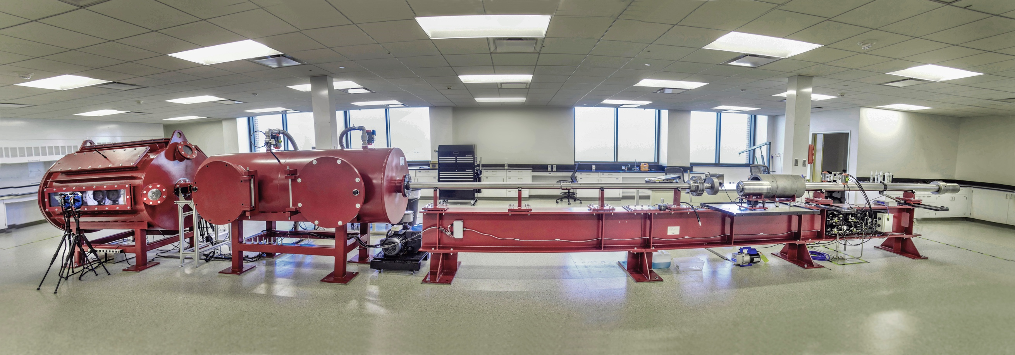





TAMU HVI Laboratory Overview
Information
Established early 2020
Location: Center for Infrastructure Renewal (CIR) at the TAMU RELLIS Campus
Projectile
Velocity: 2-8 km/s (4,400-18,000 mph)
Size: 2-10 mm (0.08-0.40 in)
Shape: cylindrical, spherical, ogive, buckshot
Target Specimen
Impact angle: 0-90°
Maximum size: 0.6 m x 0.6 m (2’ x 2’)
Maximum weight: ~90 kg (200 lb)

Slide 3
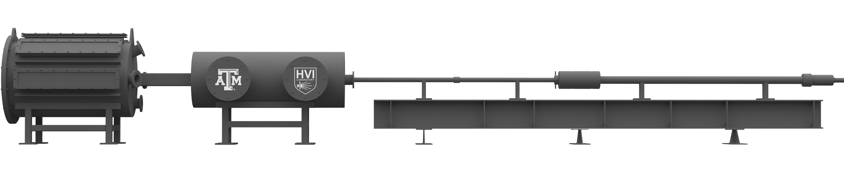
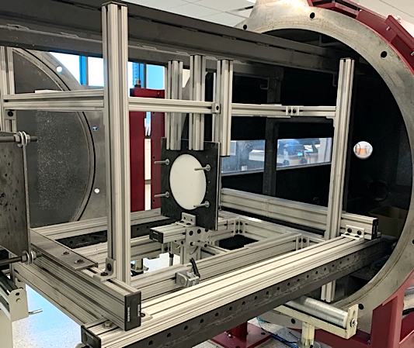
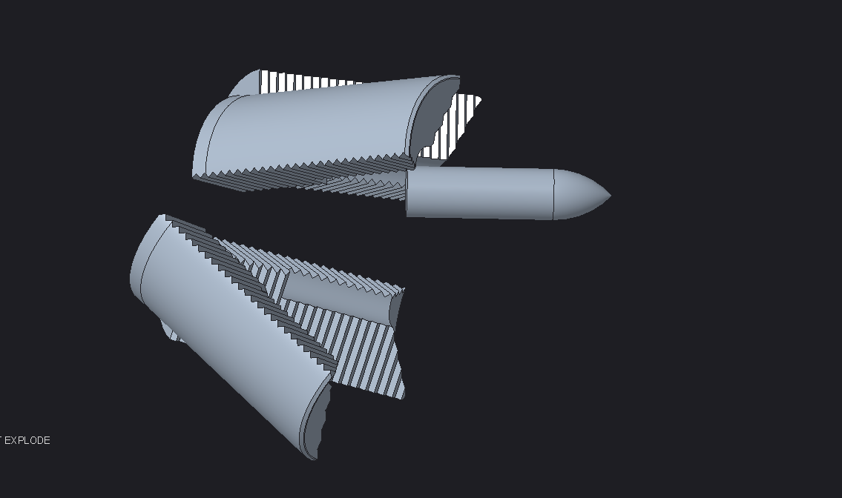
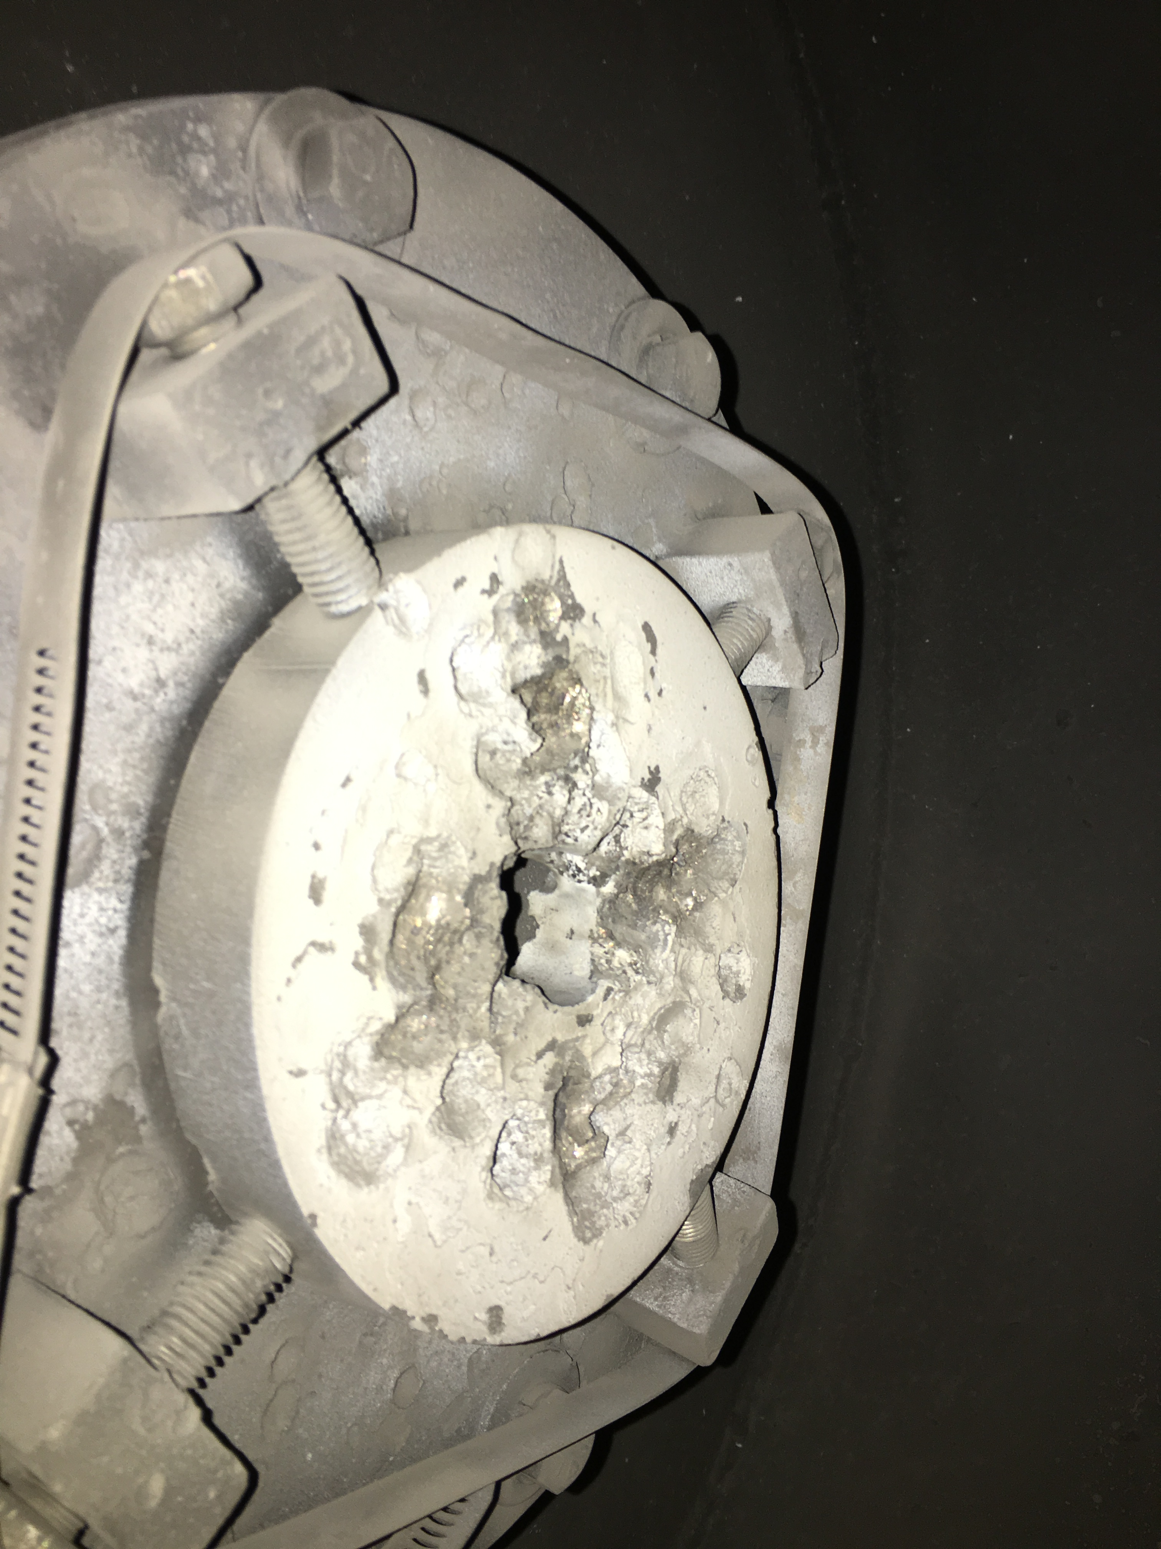
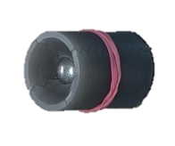
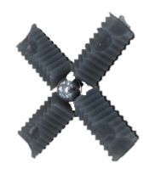
Experimental Setup – Projectile & Sabot Flight
Downrange
Uprange
Target Tank
Central Breech
Pump Tube
Powder Breech
Blast Tank
Flight Tube
1.2 m
13.7 m
Projectile impacts target
Sabot petals impact stripper plate
Sabot petals aerodynamically separate
Projectile sabot package is seated in flight tube
Target
Package ready for flight
Expanded view of package
Target Fixture

Slide 4
Simulating hypervelocity sabot separation
Purpose
Accurately predicting degree of separation increases testing effectiveness
Simulation software allows for new sabot package designs for different projectile geometries
Phase I: Empirical modelling to test simulation results
Data collected from HVI tests
Relates degree of separation (separation radius) to flight parameters
Phase II: Development of sabot flight simulation software
Uses newtonian impact theory for hypersonic flow
Numerically integrates over projectile flight to find degree of separation

Slide 5
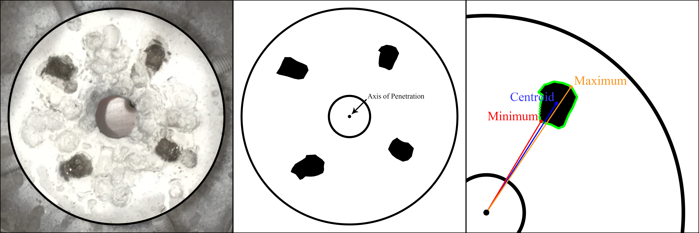
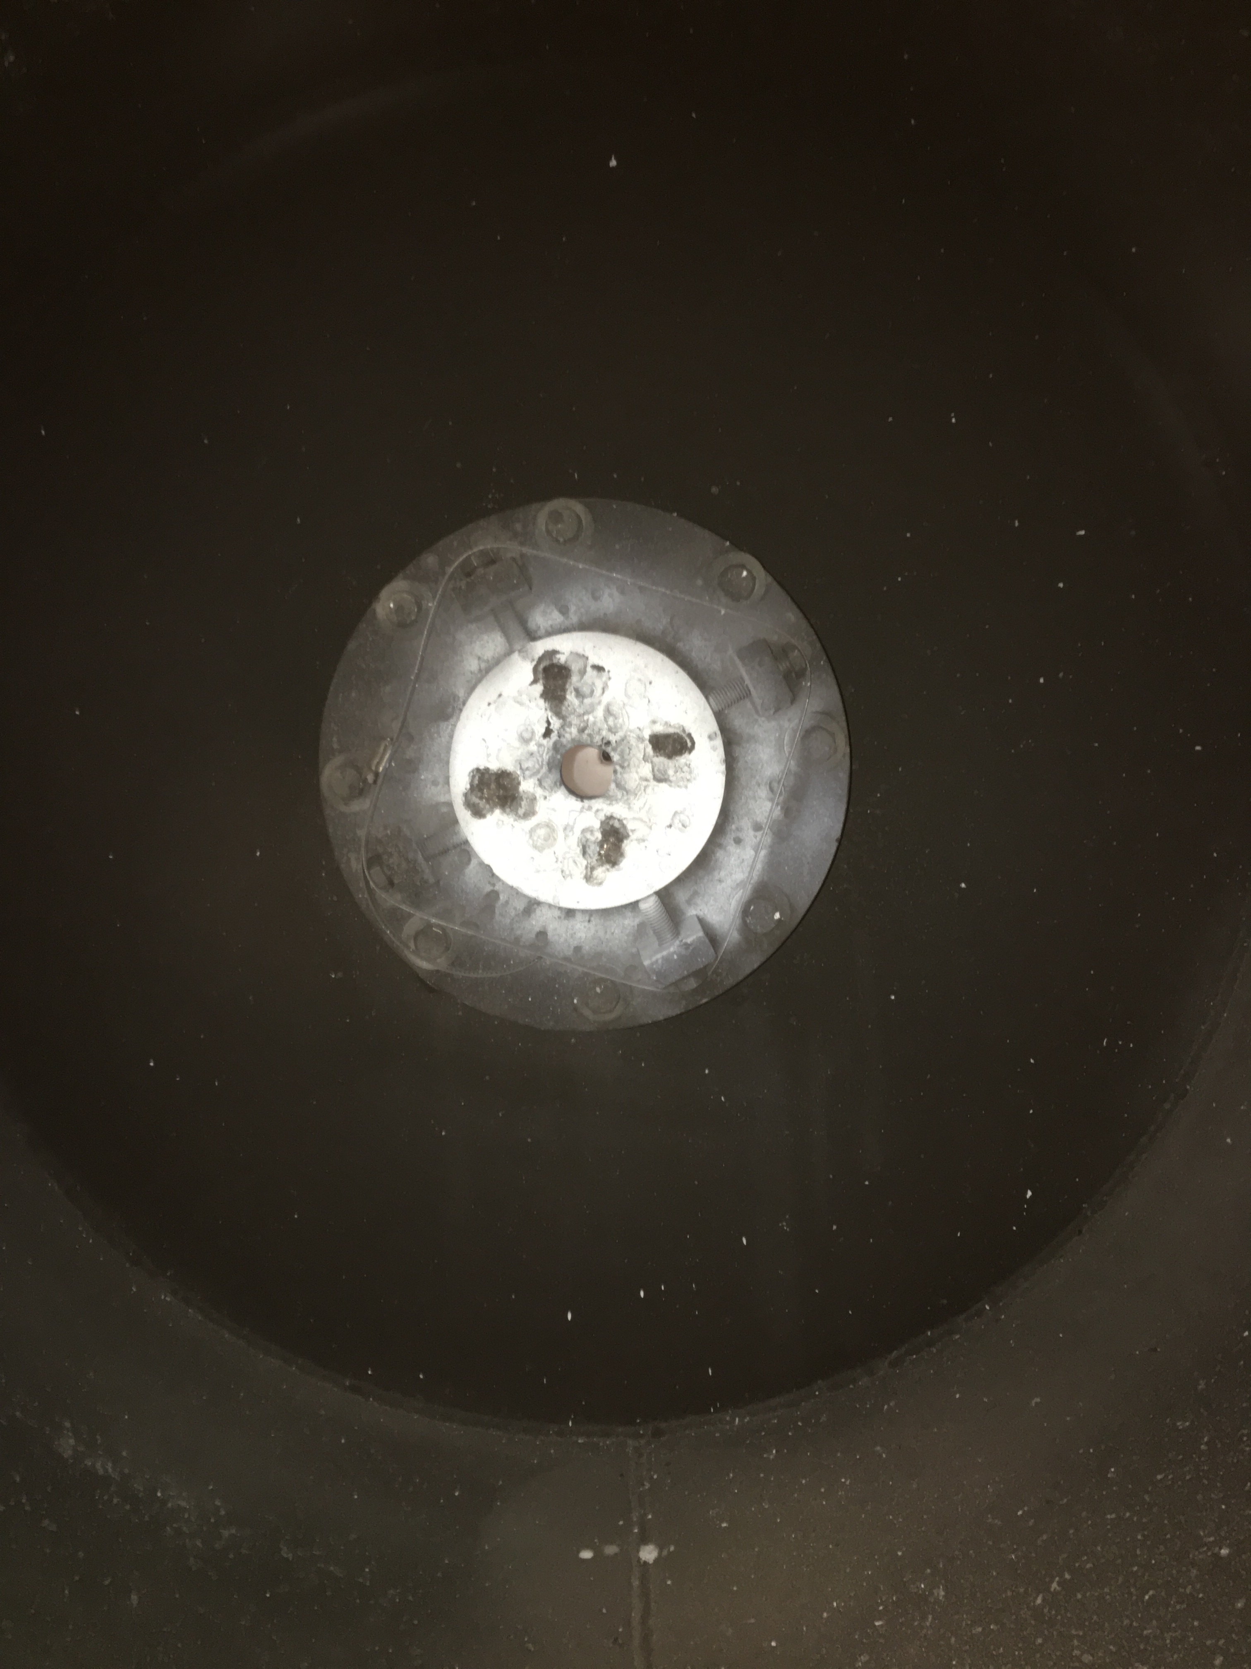
Phase I: Empirical modelling to test simulation results
Sabot petal impact photography normal to the stripper plate
Image processing using Adobe Photoshop and Python scripts to convert image data to the degree of separation

Slide 6
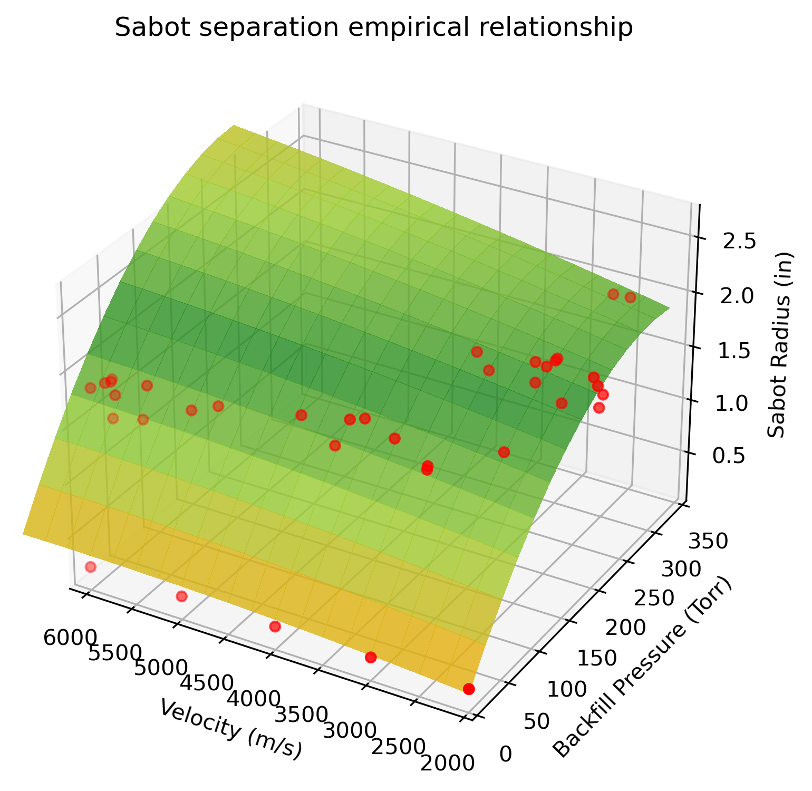
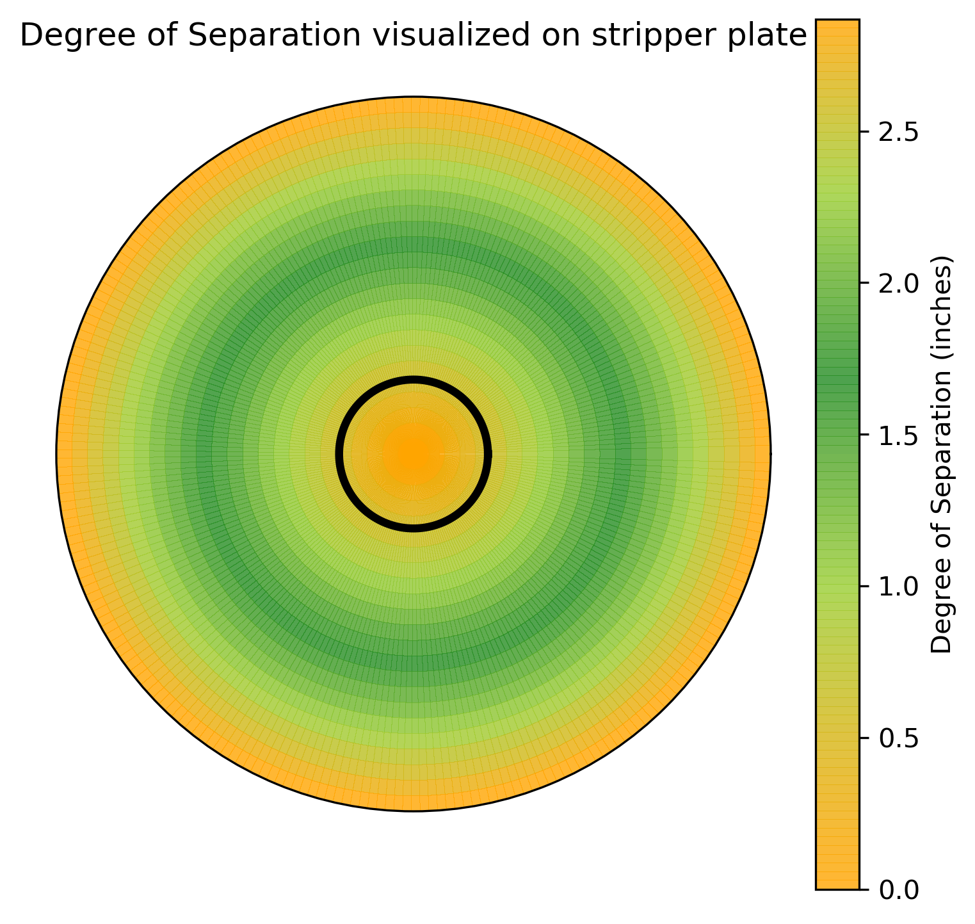
Phase I: Empirical modelling to test simulation

Slide 7
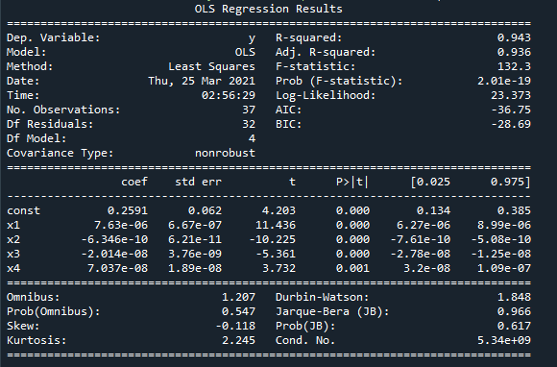
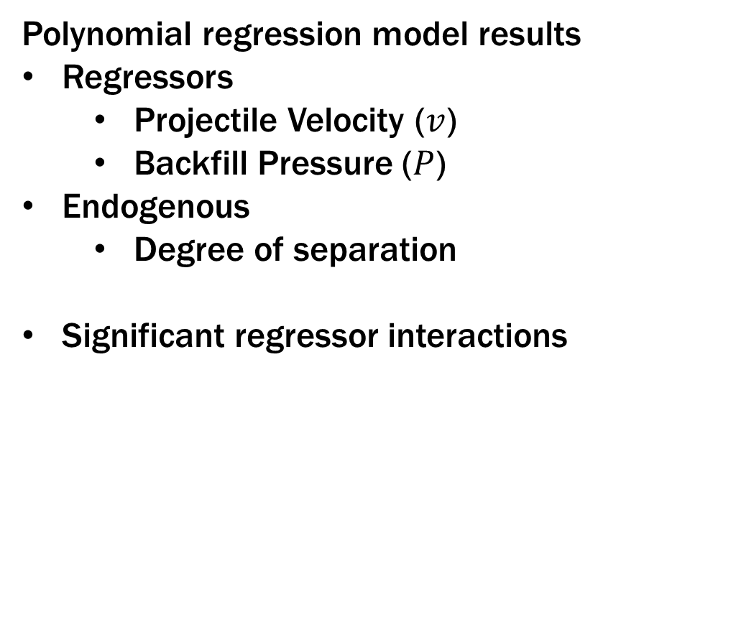
Phase I: Empirical Modelling to test simulation
Polynomial regression model results
Regressors
Projectile Velocity ($v$)
Backfill Pressure ($P$)
Endogenous
Degree of separation
Significant regressor interactions
$$\hat{Degree of separation}= x_{1}vP+x_{2}v^{2}P+x_{3}vP^{2}+x_{4}P^{3}+u$$

Slide 8
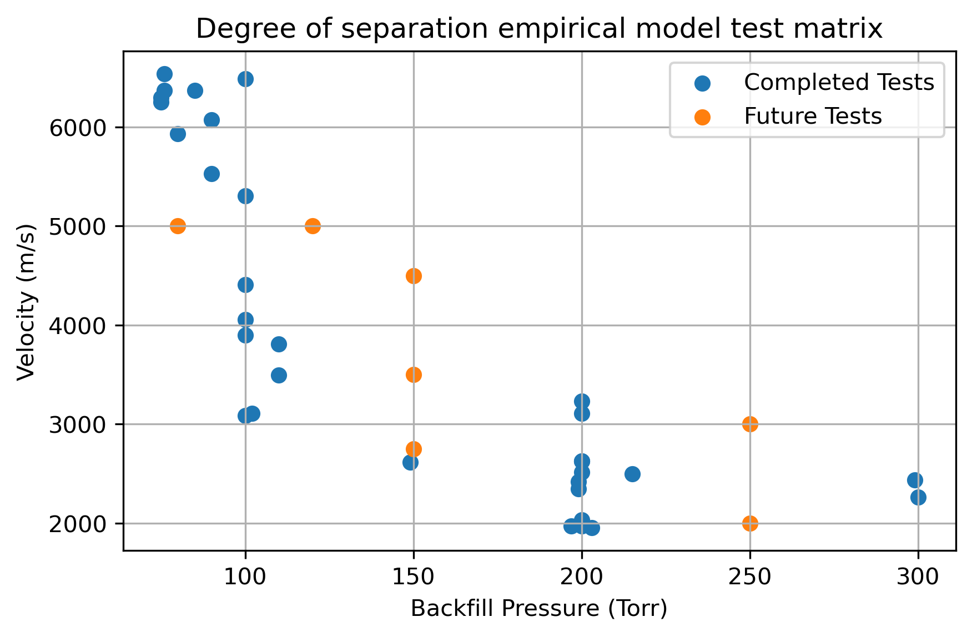
Phase II and Future Work
Finishing Phase I
Completing test matrix to improve model accuracy
Phase II
Work continues

Slide 9



Email questions to jdleaverton@tamu.edu
February 24, 2021

